Slide 1


Notions of Time
How Apache Flink™ Handles Time and Windows
Aljoscha Krettek
aljoscha@apache.org
@aljoscha

Slide 2
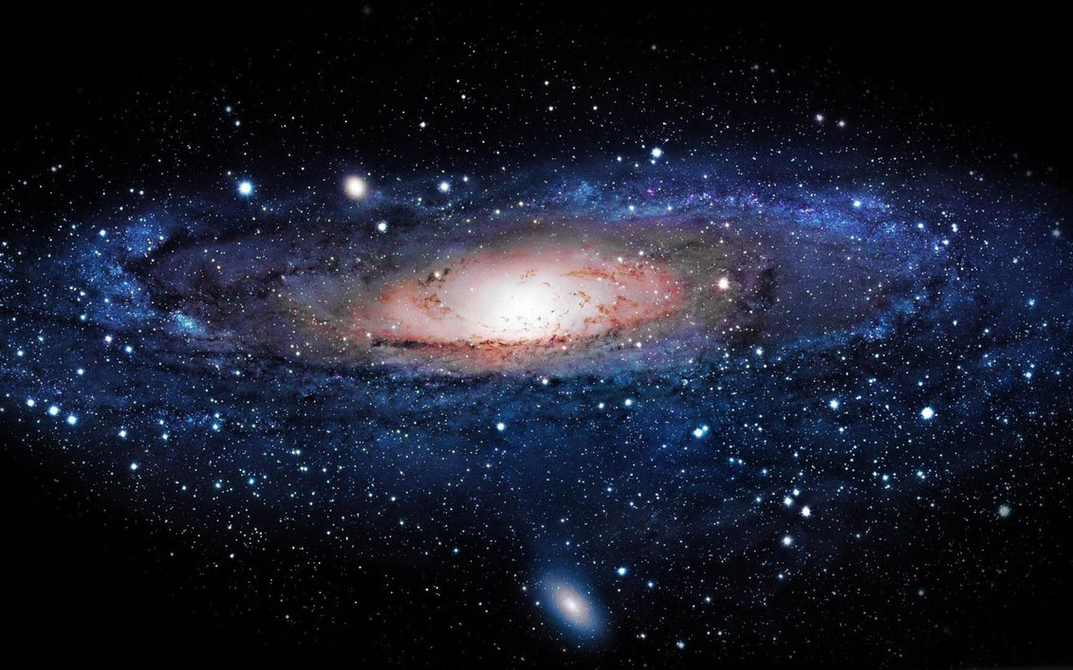
Adventures in Timespace

Slide 3
Why Windows*?
*not Microsoft Windows…

Slide 4
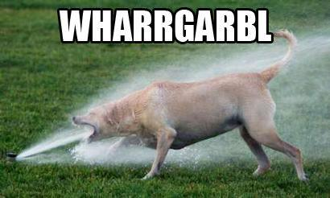
That’s why…

Slide 5

Batch
Streaming

Slide 6
In Streaming:
Arriving data never stops!

Slide 7
Solution:
Put elements into buckets,
these are called windows

Slide 8

Just saw #Trump on #CNN, super cool. :D
Window (5 min)
Count #Hashtags
Trump: 2394
Cheese: 12984
Money: 42

Slide 9
What I didn’t mention
tweets have a timestamp, their event time
tweets from across the globe arrive with delay
=> tweets with different timestamps arrive out-of-order

Slide 10


12:34 (13.10.2015):
Just saw #Trump on #CNN, super cool. :D
These arrive with 3 minutes slack
Processing Time != Event Time
Window (5 min)
Count #Hashtags
Form windows based on processing time of the machine.
Trump: 2394
Cheese: 12984
Money: 42
Notes:
Slack is the amount of time by which elements arrive late.

Slide 11
Why do people use this?
easy to implement
low latency
this is what systems give you (Spark Streaming, Apex, Samza, Storm)*
*not Google Cloud Dataflow

Slide 12
Lets look at a more
complex example.

Slide 13

These still have 3 min slack.
These have 8 min slack.
12:33 (13.10.2015):
Donald Trump speaks at Cheese conference.
Processing Time != Event Time
Window (5 min)
Correlate Tweets and News
something...

Slide 14
Processing Time != Event Time
=> Mismatch in the
timespace continuum

Slide 15
Use cases
out-of-order elements
sources with delay
recovery/fault-tolerance
“catching up” with a stream
Who does it?
Google Cloud Dataflow
Apache Flink
Notes:
Catching up, for example with elements in Kafka, you would still want correct windows based on timestamp in elements.

Slide 16
How can we do this?

Slide 17

We need a
Global Clock
that runs on
event time instead of processing time.

Slide 18
This is a source
0
2
This is the current event-time time
2
0
0
1
1
2
2
1
2
0
1
2
1
2
This is our window operator
This is a watermark.

Slide 19
Now, show me the API!

Slide 20
Processing Time
StreamExecutionEnvironment env = StreamExecutionEnvironment.getExecutionEnvironment();
env.setStreamTimeCharacteristic(ProcessingTime);
DataStream<Tweet> text = env.addSource(new TwitterSrc());
DataStream<Tuple2<String, Integer>> counts = text
.flatMap(new ExtractHashtags())
.keyBy(“name”)
.timeWindow(Time.of(5, MINUTES)
.apply(new HashtagCounter());

Slide 21
Event Time
StreamExecutionEnvironment env = StreamExecutionEnvironment.getExecutionEnvironment();
env.setStreamTimeCharacteristic(EventTime);
DataStream<Tweet> text = env.addSource(new TwitterSrc());
text = text.assignTimestamps(new MyTimestampExtractor());
DataStream<Tuple2<String, Integer>> counts = text
.flatMap(new ExtractHashtags())
.keyBy(“name”)
.timeWindow(Time.of(5, MINUTES)
.apply(new HashtagCounter());

Slide 22
TL;DL*
stream data is infinite
windows are helpful
event-time != processing time
watermarks to the rescue
Flink can do it
*too long, didn’t listen

Slide 23

flink.apache.org @ApacheFlink

Slide 24
26
20
9
4
0
42
36
35
21
33
32
26
23
21
22
20
9
5
2
1
4
3
2
1
0-3
24-27
8-11
4-7
20-23
32-35
Tumbling Windows of 4 Seconds

